Slide 1
Transit Oriented Development Advisory Group
Project Update 08/17/20

Slide 2
Proposed BRT Improvements
32 station pairs
(reviewing 28th and 90th)
17 clean fuel articulated buses
Three roundabouts

Slide 3
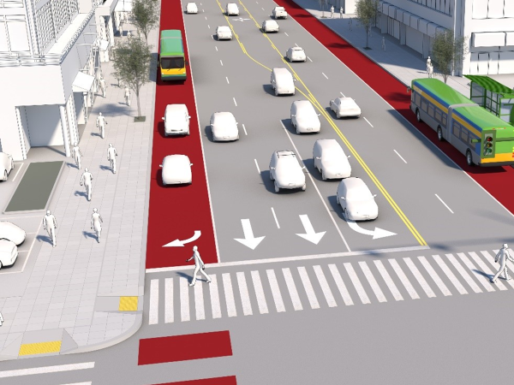

Slide 4
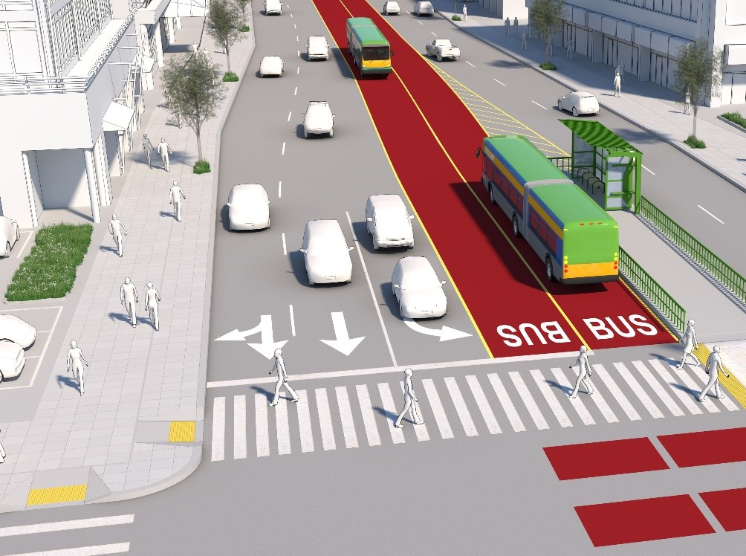

Slide 5
Pedestrian Safety and Intersection Changes

Slide 6
Median Queue Jumps
Queue jumps proposed intersection to reduce widening
Currently analyzing 38th, 56th, 72nd, and 112th

Slide 7
Median Queue Jump at 56th

Slide 8
Median Queue Jump at 72nd

Slide 9
Station Design

Slide 12
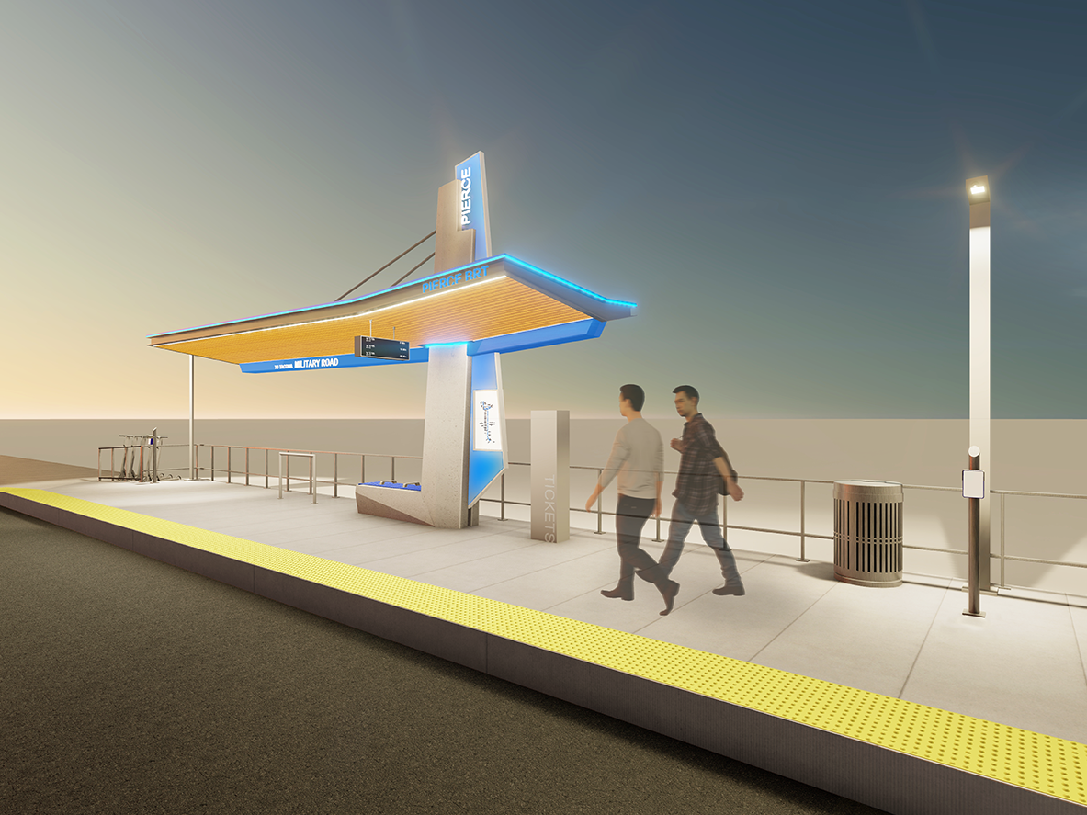
STATIONS - SUSPENSION

Slide 14
BRT Branding
System name and branding are being supported by marketing firm GreenRubino, who helped name Sound Transit’s Link light rail and Stride BRT systems.
Three system names have made it through internal and legal review. We plan to present these to our Board in August, with selection in September.
Business sponsors for naming rights to both our initial BRT line as well as BRT stations are currently being pursued.

Slide 15
Conceptual Construction Phasing Plan
CONCEPT FOR PARTNER REVIEW

Slide 16
Public Outreach Update
Launched virtual open house with fully translated sites in Spanish and Vietnamese (visit RideBRT.com)
Statistics from analytics and survey results:
1,200 sessions averaging 3.5 minutes
Largest number of viewers originate from Tacoma
Received 167 comments on station design
Top station design features:
1) real-time arrival, 2) safety enhancements, 3) weather screening
Top bus features:
1) stability poles for standing, 2) bike space, 3) adjustable air conditioning vents

Slide 17
Public Outreach Update
Virtual Zoom Open House
August 27 – 5:00 pm to 6:30 pm
Recorded for future viewing

